Slide 1

HAND GESTURE BASED VIRTUAL BLACK BOARD USING WEBCAM
2203A51L09 - B.DEVENDER
2203A51L78 - A.PRASHANTH
2203A51L52 - R.MANUSHA
2203A51L40 - N.REVANTH
2203A51L45 - P.SAI DEEPAK
GUIDED BY : Dr. J.VIJAYCHANDRA

Slide 2
CONTENTS
ABSTRACT
EXISTING SYSTEM
PROPOSED SYSTEM
SYSTEM REQUIREMENTS
SYSTEM ARCHITECTURE
SYSTEM MODULES
UML DIAGRAMS
OUTPUT SCREENS
FUTURE ENHANCEMENTS
CONCLUSION
REFERENCES

Slide 3
ABSTRACT
This project integrates machine learning into gesture recognition and voice assistance, enhancing human-computer interaction. Leveraging trained models, the system interprets user gestures for an intuitive interface, targeting applications like virtual reality, gaming, and smart devices. With extensive training on diverse datasets, the system achieves high accuracy, fostering natural communication. This research contributes to interactive technologies, paving the way for innovative and user-friendly applications, thus enriching the evolving landscape of Human Interaction-Computer Interface.

Slide 4
EXISTING SYSTEM
Basic Voice Assistance:
Users can interact with the system using voice commands.
Limited to basic commands and responses.
No dynamic gestures or virtual keyboard integration.
Static Virtual Keyboard:
Users can input text using a virtual keyboard.
Limited interaction and may not be user-friendly for those with mobility issues.
No Dynamic Gesture Support:
Lack of dynamic gestures for more intuitive interaction.
Users are confined to voice commands or manual virtual keyboard input.

Slide 5
PROPOSED SYSTEM
Enhanced Voice Assistance:
Integration of advanced natural language processing for more complex voice commands.
Capability to trigger dynamic gestures and virtual keyboard interactions through voice commands.
Dynamic Gesture Recognition:
Implementation of a dynamic gesture recognition system.
Users can perform gestures to control various aspects of the system.
Gestures can include commands for navigation, selection, and other interactive functionalities.
Virtual Keyboard Improvement:
Integration with dynamic gestures for more versatile control.
Option to activate the virtual keyboard through both voice commands and gestures.
Integration of Voice, Gesture, and Keyboard.

Slide 6
SYSTEM REQUIRMENTS
Software Requirements :
Operating System : Windows 10
Simulation Tool : Anaconda
Language : Python
Hardware Requirements :
RAM : 4 GB
Hard Disk : 10 GB
Processor : Intel i7
Devices : Personal computer with camera of 2mp

Slide 7
SYSTEM ARCHITECTURE

Slide 8
SYSTEM MODULES
Initialization of Camera
Mapping and Extraction of all Hand Gestures
Co-relating the Resolution of Camera Window and Screen.
Recognition and Execution of Hand Gestures.
Voice assistant

Slide 9
1) Initialization of Camera :
It is crucial to match the resolution of the system screen with the resolution of the camera window being used because the camera is used through an image as the user moves their finger in the camera window. So, it becomes important to determine how many pixels are moved on the actual screen if the user moves by 1 pixel in the camera window. The maximum distance between the user and the camera must be 0.75 meters.With the commands, the resolution of the screen can be estimated.
2) Mapping & Extraction of Hand Gesture :
The mapping is assigned binary integers because the cursor will move across the entire screen. A number of hand features that are utilised to recognise gestures are extracted using the Mediapipe programme. The subtraction method, which is simple and efficient for hand detection from the original image, is used.

Slide 10
3) Co-relating the Resolution of Camera Window and Screen :
The many motions that the acquisition toolkit will employ to record the user's finger as it moves. The camera must be able to record at least 15 frames per second.
4) Recognition and Execution of Hand Gestures :
The identification and execution of purposeful hand motions are made possible by the successful mapping and extraction of distinct hand features. To do this, the Mediapipe and Open CV modules are both utilised. The quantity and variety of fingers present can be used to predict hand actions.A gesture made with five fingers is classified as a neutral gesture, one made with two fingers as a move cursor gesture, one made with the right finger pulled down as a right click, etc.
5) Voice assistant :
The initial phase in the process involved examining the audio commands that the user had delivered through the microphone. This might entail gathering data or controlling the computer's internal data and other thing.

Slide 11
UML DIAGRAMS
CLASS DIAGRAM
USE CASE DIAGRAM
SEQUENCE DIAGRAM
ACTIVITY DIAGRAM
DATA FLOW DIAGRAM

Slide 12
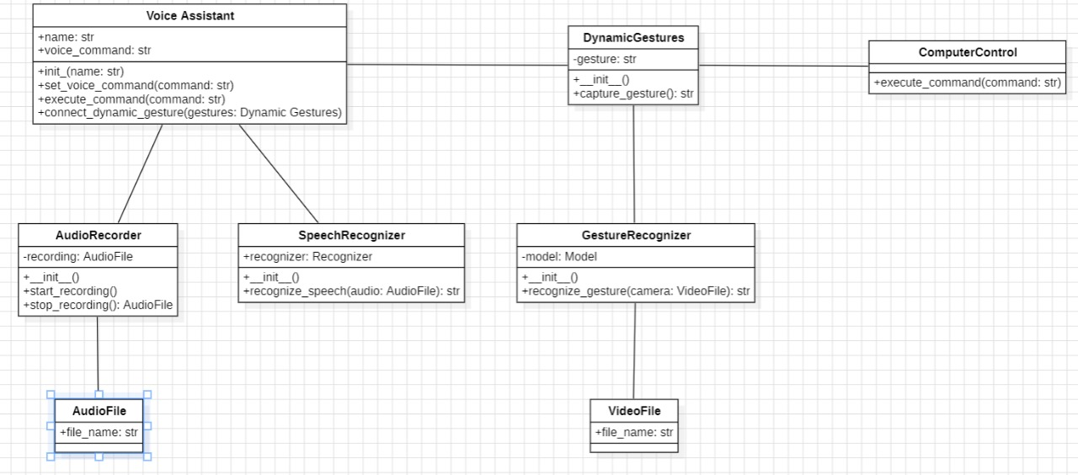
CLASS DIAGRAM

Slide 13
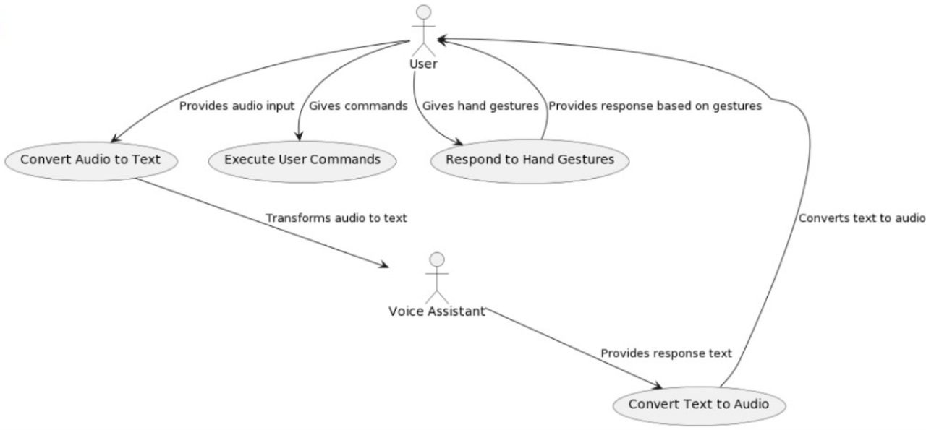
USECASE DIAGRAM

Slide 14
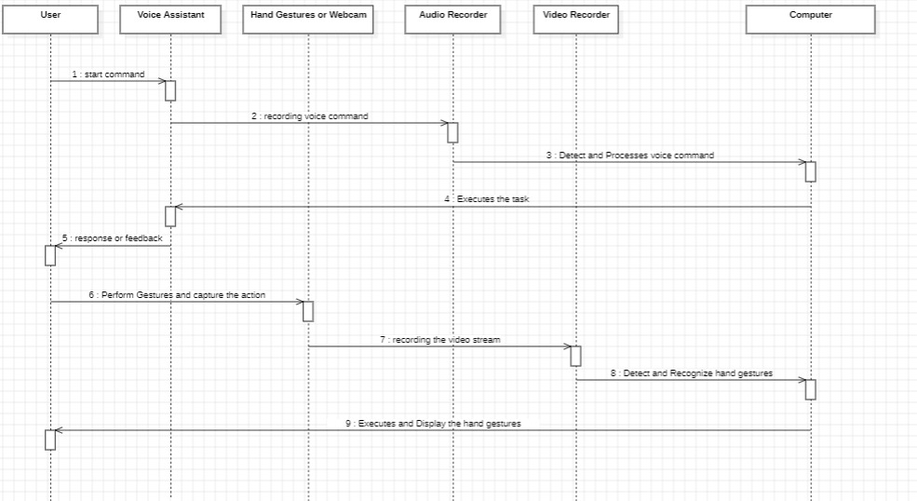
SEQUENCE DIAGRAM

Slide 15
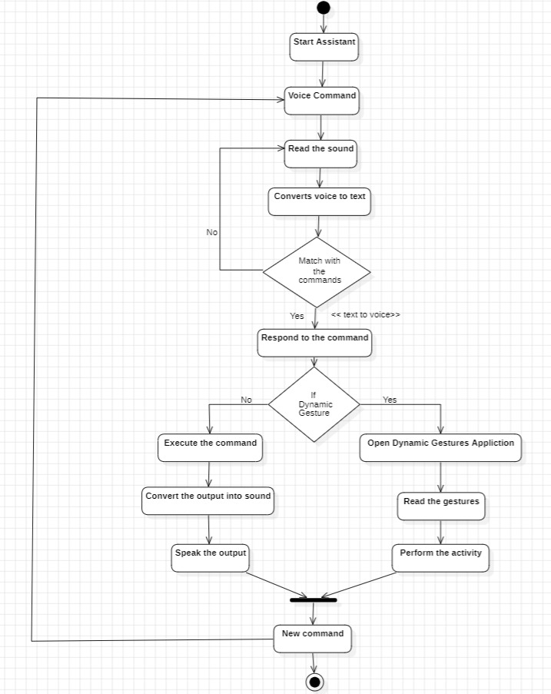
ACTIVITY DIAGRAM
Yes
No

Slide 16
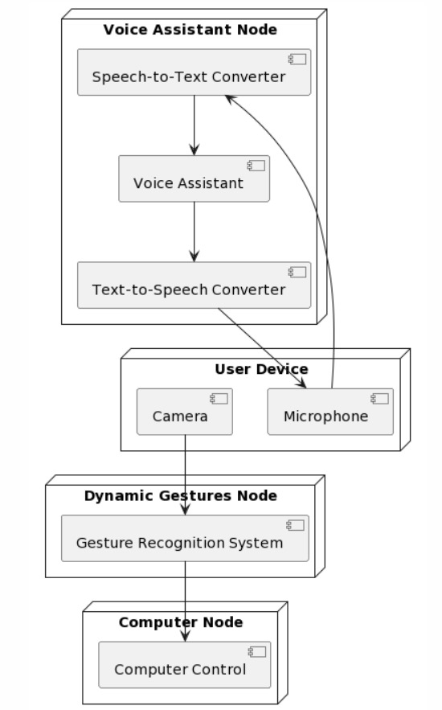
DEPLOYMENT DIAGRAM

Slide 17
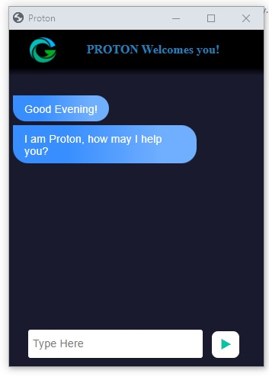
OUTPUT SCREENS
Fig 1: Represents initial user interface

Slide 18
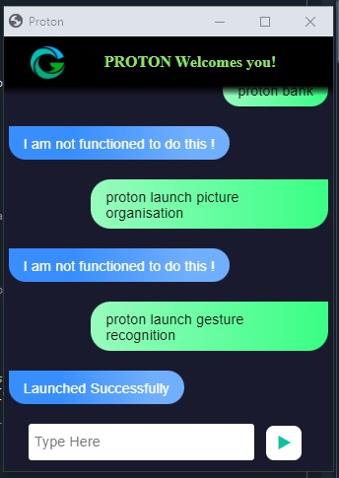
Fig 2: Represents the response after giving a command

Slide 19
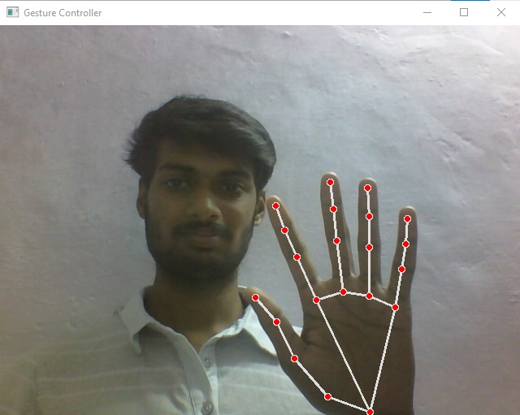
Fig 3: Represents performing Dynamic Gesture

Slide 20
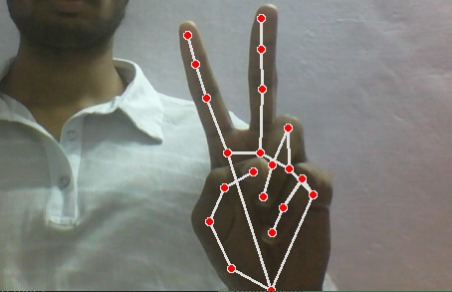
Fig 4: Represents performing Dynamic Gesture

Slide 21
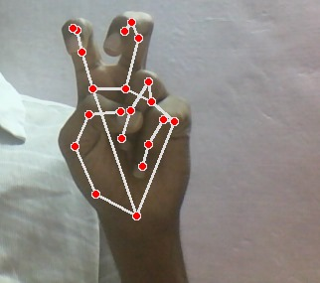
Fig 5: Represents performing Dynamic Gesture

Slide 22
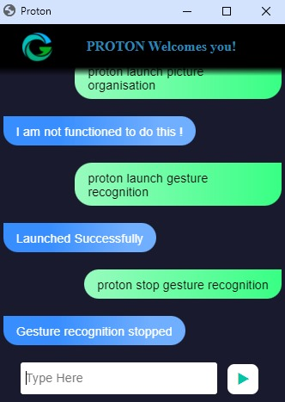
Fig 8.6: Represents the response after giving a command

Slide 23
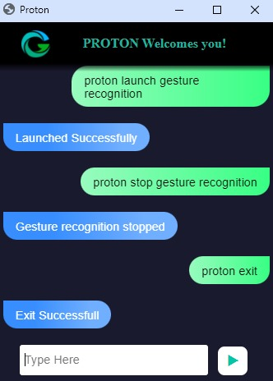
Fig 7: Represents the termination

Slide 24
FUTURE ENHANCEMENTS
The Hand Gesture recognition is moving at tremendous speed for the futuristic products and services and major companies are developing technology based on the hand gesture system and that includes companies like Microsoft, Samsung, Sony and it includes the devices like Laptop, Hand held devices, Professional and LED lights The verticals include, where the Gesture technology is and will be evident are Entertainment, Artificial Intelligence, Education and Medical and Automation fields.
And with lot f Research and Development in the field of Gesture Recognition Field, the use and adoption will become more cost effective and cheaper. It’s a brilliant feature turning data into features with mix of technology and Human wave. Smart phones have been experiencing enormous amount of Gesture Recognition Technology with look and views and working to manage the Smartphone in reading, viewing and that includes what we call touch less gestures. Google Glass has been also in the same cadre. And the Technology has also been embedded into smart televisions nowadays as well, which can easily control and managed by Voice and Hand options. In the medical fields Hand Gesture may also be experienced in terms of Robotic Nurse and medical assistance. As the Technology is always revolving and changing the future is quiet unpredictable but we have to be certain the future of Gesture Recognition is here to stay with more and eventful and Life touching experiences.

Slide 25
CONCLUSION
The main purpose of this paper is to implement the idea of a Virtually controlled system. The main tasks performed are cursor operations, Keyboard operations, writing, and voice-totext converter. From all the above discussion it can be concluded that a Hand gesture-based system plays a significant role in interacting with the computer as a virtual machine and also reduces the hardware cost by eliminating the use of a mouse and keyboard. This system is developed in such a way that a simple Webcam is sufficient enough to identify hand gestures and perform operations. The developed system can be used for educational purposes. Smart classrooms can be implemented using hand gestures which reduce time and also minimizes the use of hardware. The system also acts as a user-friendly device for physically challenged and aged people by providing them with an interface for communication. This system can be convenient for presentations and useful for reducing the workspace and burden of extra hardware devices. Since it replaces the hardware devices, it brings the user and their workspace much closer to them than before.

Slide 26
REFERENCES
F. Soroni, S. a. Sajid, M. N. H. Bhuiyan, J. Iqbal and M. M. Khan, "Hand Gesture Based Virtual Blackboard Using Webcam," 2021 IEEE 12th Annual Information Technology, Electronics and Mobile Communication Conference (IEMCON), 2021, pp. 0134-0140, doi: 10.1109/IEMCON53756.2021.9623181.
R. Lyu et al., "A flexible finger-mounted airbrush model for immersive freehand painting," 2017 IEEE/ACIS 16th International Conference on Computer and Information Science (ICIS), 2017, pp. 395-400, doi: 10.1109/ICIS.2017.7960025.
Prof. S.U. Saoji, Nishtha Dua, Akash Kumar Choudhary, Bharat Phogat “Air Canvas application using OpenCV and NumPy in python”International Research Journal of Engineering and Technology, Volume: 08, Issue 08 Aug 2021.
K. V. V. Reddy, T. Dhyanchand, G. V. Krishna and S. Maheshwaram, "Virtual Mouse Control Using Colored Finger Tips and Hand Gesture Recognition ", 2020, doi:10.1109/HYDCON48903.2020.9242677.
P. Ramasamy, G. Prabhu and R. Srinivasan, "An economical air writing system converting finger movements to text using web camera," 2016 International Conference on Recent Trends in Information Technology (ICRTIT), 2016, pp. 1-6, doi: 10.1109/ICRTIT.2016.7569563.
C. D. Sai Nikhil, C. U. Someswara Rao, E. Brumancia, K. Indira, T. Anandhi and P. Ajitha, "Finger Recognition and Gesture based Virtual Keyboard," 2020 5th International Conference on Communication and Electronics Systems (ICCES), 2020, pp. 1321-1324, doi: 10.1109/ICCES48766.2020.9137889.

Slide 27
THANK YOU

